Slide 1
電腦視覺與深度學習 (Computer Vision and Deep Learning) Homework 2
TA:
Lydia: lydia2200284@gmail.com
Office Hour: 17:00~19:00, Mon.
10:00~12:00, Wed.
At CSIE 9F Robotics Lab.

Slide 2
Notices (1/2)
Copying homework is strictly prohibited!! Penalty: Grade will be zero for both persons!!
If the code can’t run, you can come to our Lab within one week and show that your programming can work. Otherwise you will get zero!!
Due date => Midnight 23:59:59 on 2020/12/30 (Wed.)
No delay. If you submit homework after deadline, you will get 0.
Upload to => 140.116.154.1 -> Upload/Homework/Hw2
User ID: cvdl2020 Password: cvdl2020
Format
Filename: Hw2_StudentID_Name_Version.rar
Ex: Hw2_F71234567_林小明_V1.rar
If you want to update your file, you should update your version to be V2, ex: Hw2_F71234567_林小明_V2.rar
Content: project folder*( including the pictures ) *note: remove your “Debug” folder to reduce file size

Slide 3
Notices (2/2)
Python
Python 3.7 (https://www.python.org/downloads/)
opencv-contrib-python (3.4.2.17)
Matplotlib 3.1.1
UI framework: pyqt5 (5.15.1)
C++ (check MFC guide in ftp)
OpenCV 3.3.1 (https://opencv.org/release.html)
Visual Studio 2015 (download from http://www.cc.ncku.edu.tw/download/)
UI framework: MFC

Slide 4
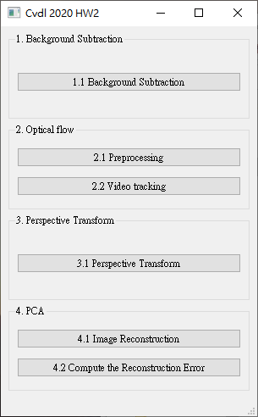
Grading
1. (20%) Background Subtraction (出題：Brian)
2. (20%) Optical Flow (出題：Kevin) 2.1 Preprocessing (10%)
2.2 Video tracking (10%)
3. (20%) Perspective Transform (出題：Max)
4. (20%) PCA (出題：Mark)
4.1 Image Reconstruction (10%)
4.2 Compute the reconstruction error (10%)
5. (20%) Dogs and Cats classification Using ResNet50 (出題：Bill)
UI example

Slide 5
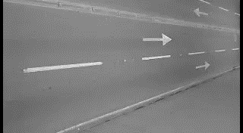
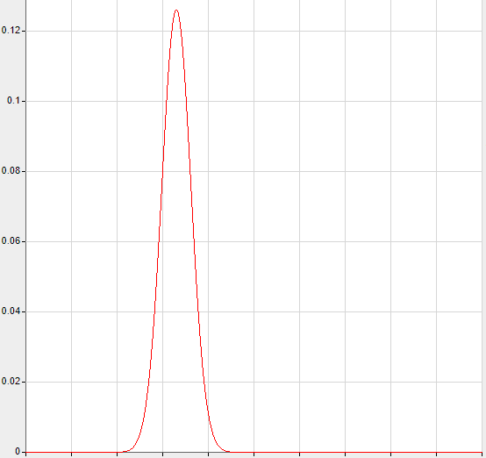
1. (20%) Background Subtraction: Simple Gaussian Model (1/2) (出題：Brian)
Given a video: bgSub.mp4
Q: 1) Click the button “1.1 Background Subtraction” to open two windows:
One shows the original video: bgSub.mp4
The other is the foreground video.
Use first 50 frames to build the background model
DO NOT use OpenCV function cv2.createbackgroundSubstractor()
1. Build background model
Build one gaussian model at every pixel position
frame = 0 ~ 50
Image height
Background gaussian model
Each pixel will have a mean
and a standard deviation (total width x height models)
0~50 frame
Image width
Output: w x h gaussian models (mean and std)
2. Test new pixel belongs to background or foreground
mean ex: 25
mean ex: 25
std * 5 ex: 3*5
std * 5 ex: 3*5
Ex:
Mean = 25
Std (standard deviation) = 3
new pixel value ex: 28
new pixel value ex: 60
Belongs to Background
Belongs to Foreground

Slide 6
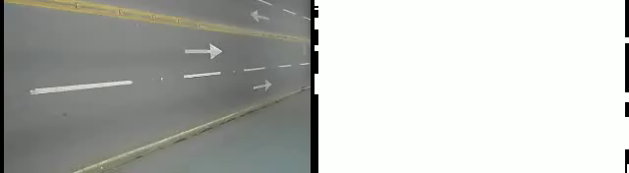
1. (20%) Background Subtraction: Simple Gaussian Model (2/2) (出題：Brian)
Hint : (1) Convert video frames to gray
(2) For every pixels in video from 0~50 frames, build a gaussian model with mean and standard deviation (if standard deviation is less then 5, set to 5)
(3) For frame > 50, test every frame pixels with respective gaussian model. If gray value difference between testing pixel and gaussian mean is larger than 5 times standard deviation, set testing pixel to 255 (foreground, white), 0 (background, black) otherwise.
Demo video:

Slide 7
2. (20%) Optical Flow (出題：Kevin)
2.1 Preprocessing (10%)
2.2 Video tracking (10%)

Slide 8

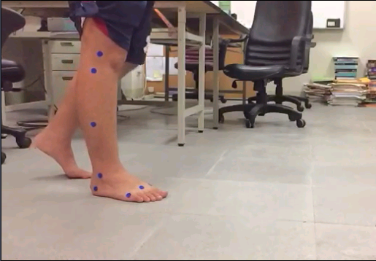
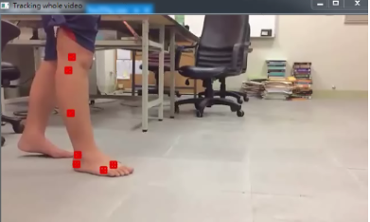
2.1 Preprocessing (10%) (出題：Kevin)
Given a video: opticalFlow.mp4
Q: Click the button to show the square boundary with red cross mark (not red filled like the ex. image).
window size: 11
Center point
Ex:
7 blue circles
(0,0)
x
y

Slide 9
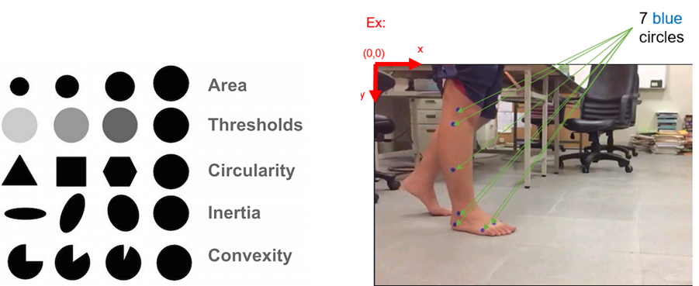
How to detect 7 center points of 7 blue circles
You can use cv2.SimpleBlobDetector() to detect blobs (binary large object), it can filter out blobs by examining their:
Area (size)
Thresholds (gray level)
Circularity (if perfect circle, then it is 1.0)
Inertia (ratio of the minor and major axes )
Convexity (if no gap, then it is 1.0)

Slide 10

2.2 Video tracking (10%) (出題：Kevin)
Q: Click button to:
(5%) Track the 7 center points on the whole video using OpenCv function cv2.calcOpticalFlowPyrLK. Ex: https://github.com/opencv/opencv/blob/master/samples/cpp/lkdemo.cpp
(5%) Connect 7 corresponding tracking points of all frames (the whole video) to get 7 trajectories (flow). Ex: the demo video.
Demo video:
Tool site:
Load video
Circle detect
Optical flow
※ Tracking process may be fail, you should make the result as good as possible (at least 4~5 points success)

Slide 11
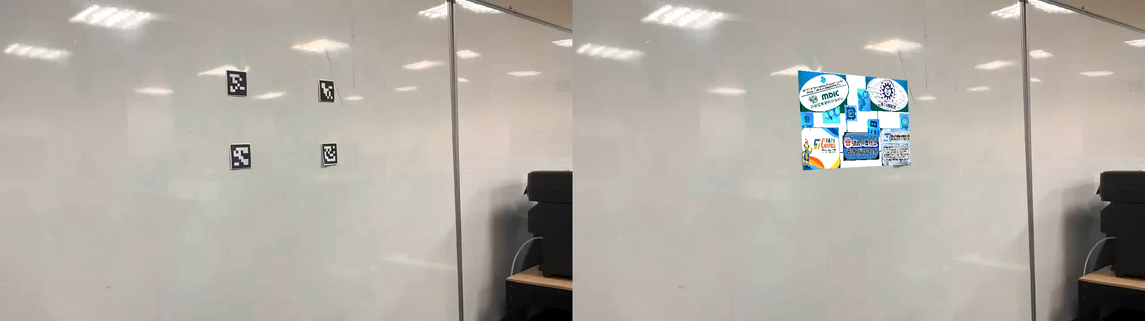
3. (20%) Perspective Transform: (出題：Max)
Given a video: test4perspective.mp4
Q: 1) Click the button “ 3.1 Perspective Transform” to show and save result video:
Hint : (1) Read the test video and process frame by frame
(2) Detect the ArUco maker inside the frames
(3) Get the pixel position (x,y) of four makers in the frame
(4) Do perspective transform
(5) Show result video and save it
Demo video:
Next page will show you
how to detect ArUco Maker
Please do perspective
transform by you own
with opencv

Slide 12
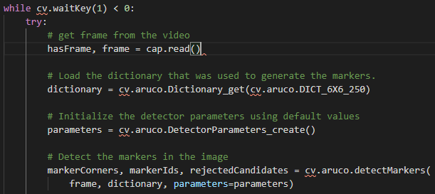
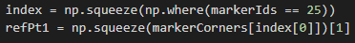
Hints: How to use ArUco Makers (1/2) (出題：Max)
Step 1: You need to dectect the aruco makers inside each frame as below
Step 2: Then you can get the pixel value of each makers, for example
you can get pixel value of makers which’s ID is 25

Slide 13
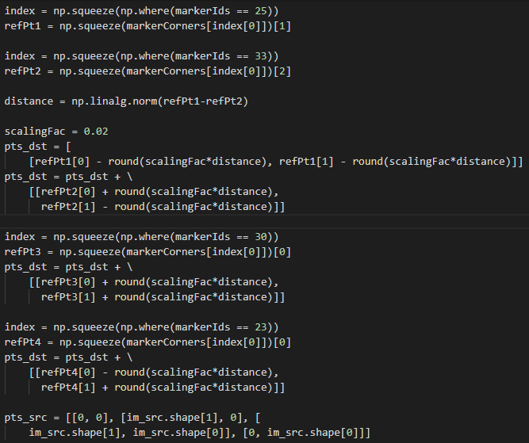
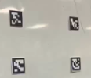

Hints: How to use ArUco Makers (2/2) (出題：Max)
Step 3: Then calculate the four edges of the region you want to perspective,
pts_dst are four points
ID 25
ID 33
Find makers 25,33
ID 23
ID 30
Calculate the edge points for perspective
pts_src are also four points

Slide 14
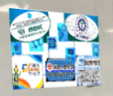
3. (20%) Perspective Transform: (出題：Max)
Do the perspective transform
- The function you will use for perspective transform
retval, mask=cv2.findHomography(srcPoints, dstPoints[, method[,
ransacReprojThreshold[, mask[, maxIters[, confidence]]]]])
dst = cv2.warpPerspective(src, M, dsize[, dst[, flags[, borderMode[,
borderValue]]]])
(0,0)
x
y
Result:

Slide 15
4. (20%) PCA (出題：Mark)
4.1 Image Reconstruction (10%)
4.2 Compute the reconstruction error (10%)

Slide 16
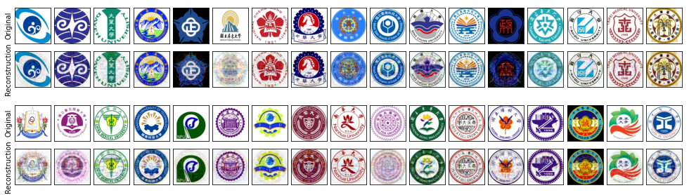
4.1 (10%) PCA - Image Reconstruction (1/2) (出題：Mark)
Given: Images of school badge
Q1: Using PCA to do dimension reduction then reconstruct, click button “4.1 Image Reconstruction” and show original and reconstructed images.
Hint: Use PCA from python library sklearn.decomposition

Slide 17
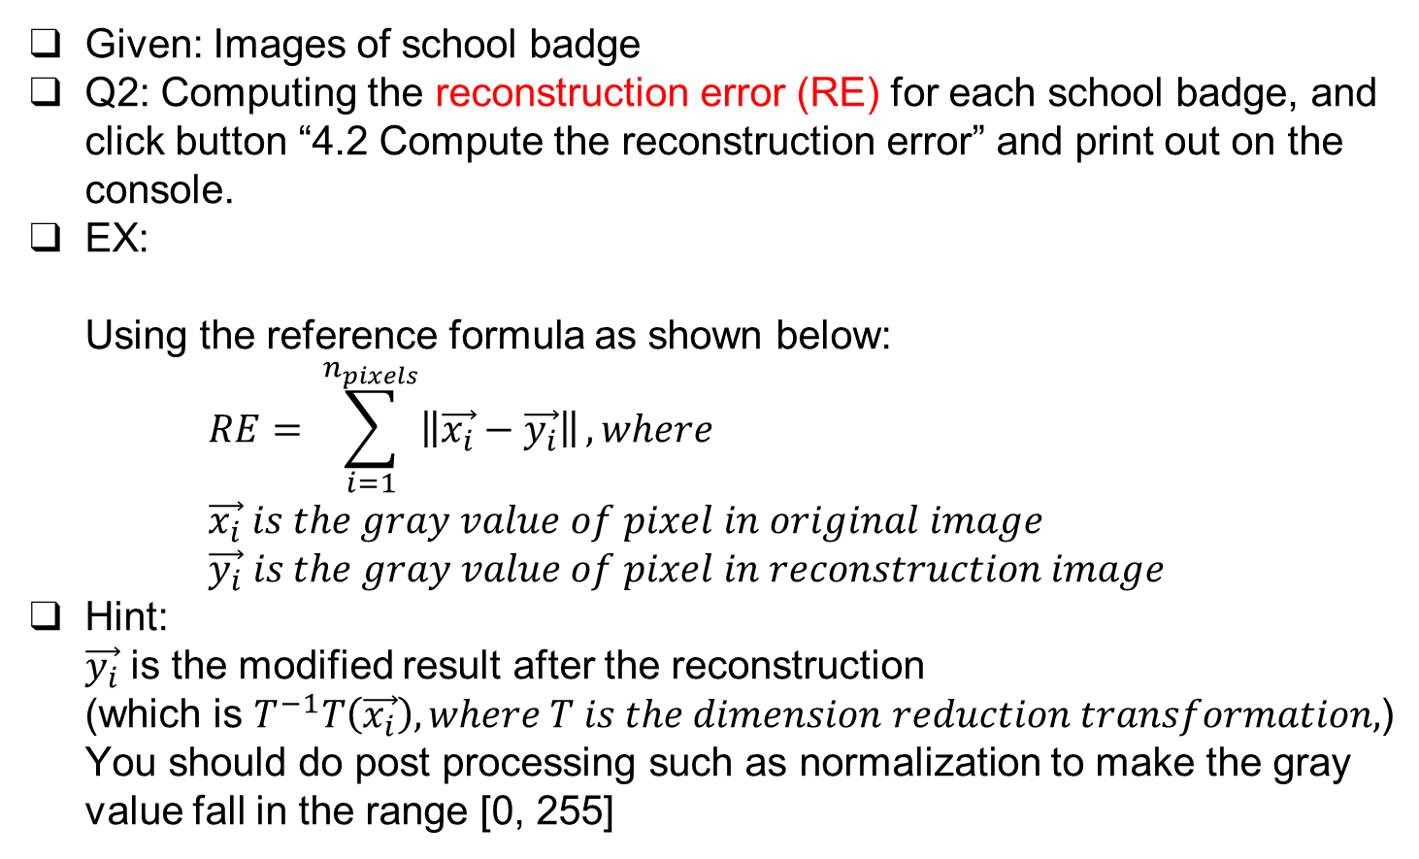
4.2 (10%) PCA - Compute the Reconstruction Error (2/2) (出題：Mark)
Given: Images of school badge
Q2: Computing the reconstruction error (RE) for each school badge, and click button “4.2 Compute the reconstruction error” and print out on the console.
EX: Using the reference formula as shown below: $RE= \sum_{i=1}^{n_{pixels}}{\left\|\vec{x_{i}}−\vec{y_{i}}\right\|}, where$ $\vec{x_{i}} is the gray value of pixel in original image$ $\vec{y_{i}} is the gray value of pixel in reconstruction image$
Hint: $\vec{y_{i}}$ is the modified result after the reconstruction (which is $T^{−1}T\left(\vec{x_{i}}\right), where T is the dimension reduction transformation,$) You should do post processing such as normalization to make the gray value fall in the range [0, 255]

Slide 18
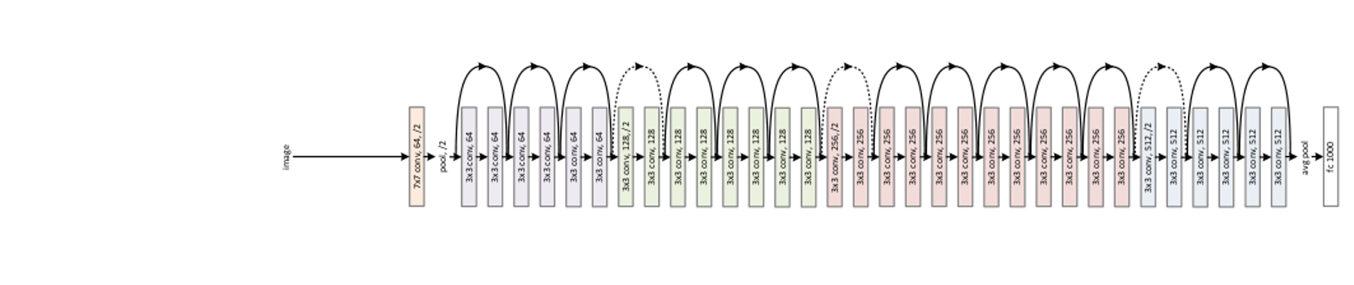
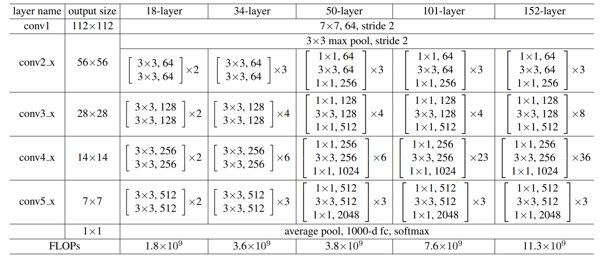
5.0 (20%)Dogs and Cats classification Using ResNet50 (出題：Bill)
1) Dataset introduction:
ASIRRA (Animal Species Image Recognition for Restricting Access) is a HIP(Human Interactive Proof) that works by asking users to identify photographs of cats and dogs, that's supposed to be easy for people to solve, but difficult for computers. Now we can use artificial intelligence technology to achieve this goal.
(2) The dataset includes 12501 photos of cats and 12501 photos of dogs. You need to download them in Reference below(R2), and split the training set, validation set and test set by yourself.
2) Objective:
You need to use python to write the ResNet network
and complete the questions on the next few pages.
3) Environment Requirement
(1) Python 3.6
(2) Tensorflow 1.14
(3) Opencv-contrib-python 4.1.1 (for image show and write)
Fig. ResNet’s Network Architecture
R. Reference
R1) Deep Residual Learning for Image Recognition
R2) https://www.microsoft.com/en-us/download/details.aspx?id=54765 (ASIRRA)
Fig. ResNet50's Schematic Diagram

Slide 19
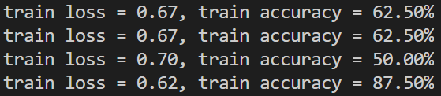
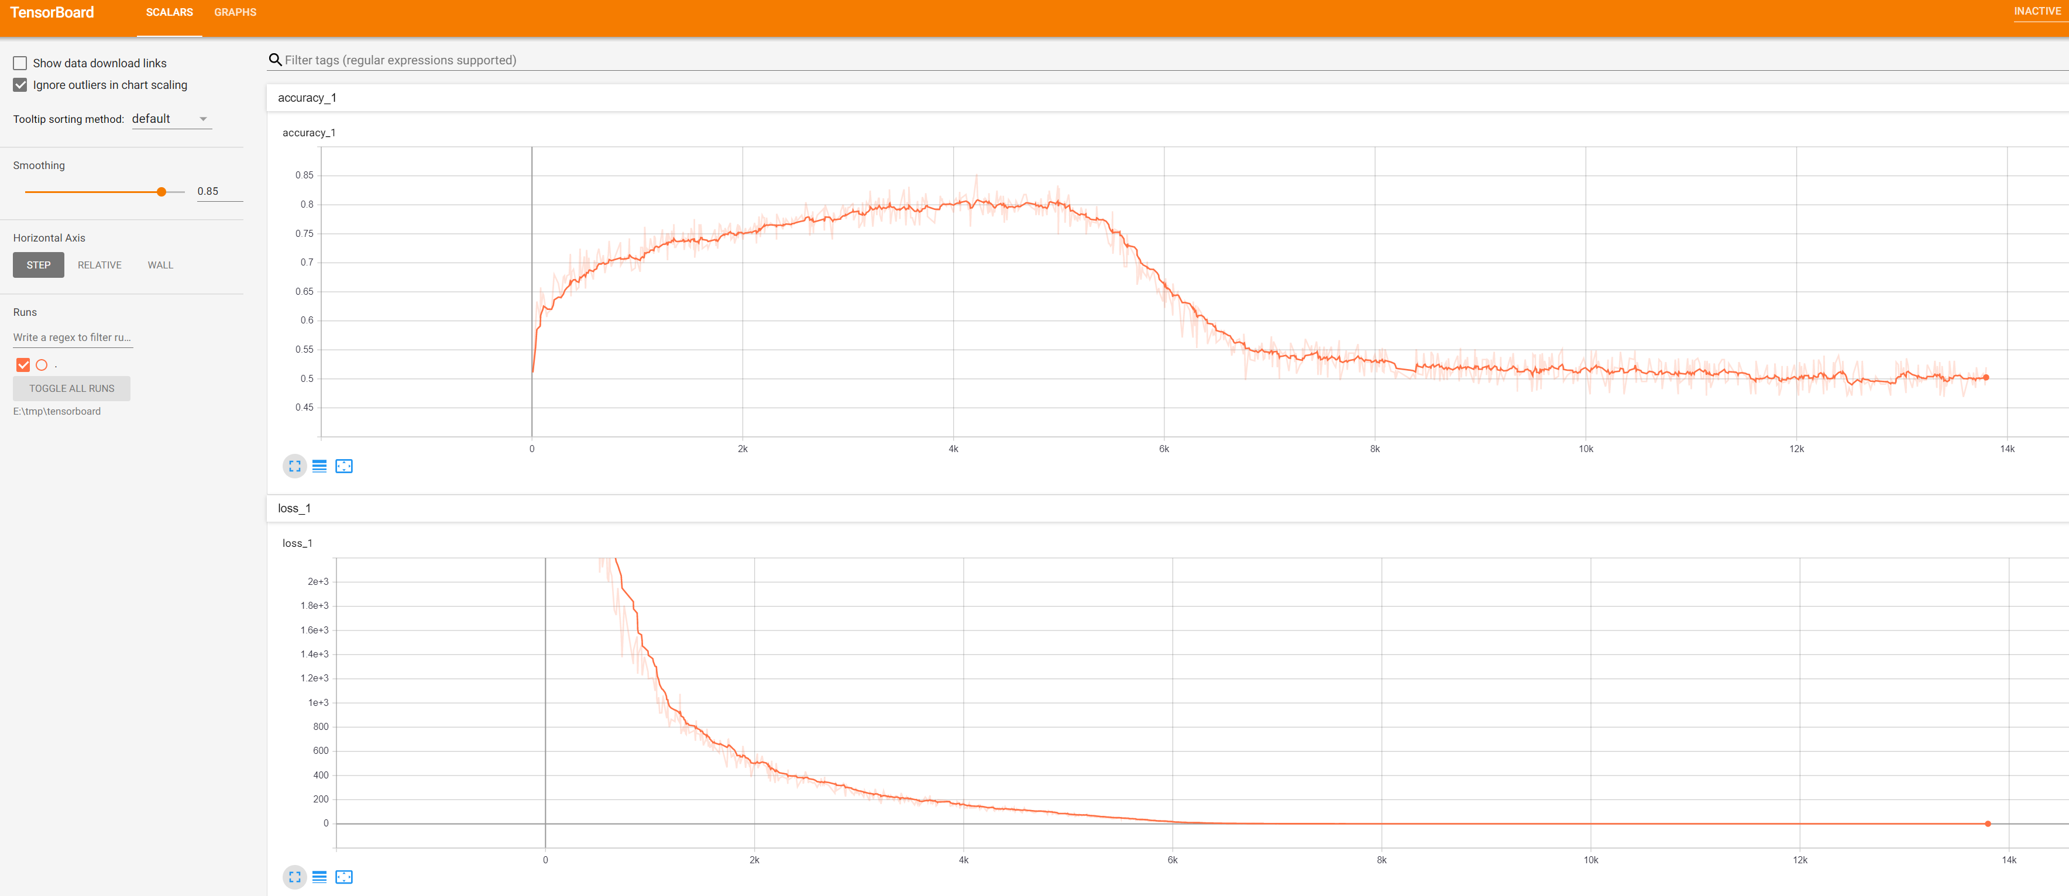
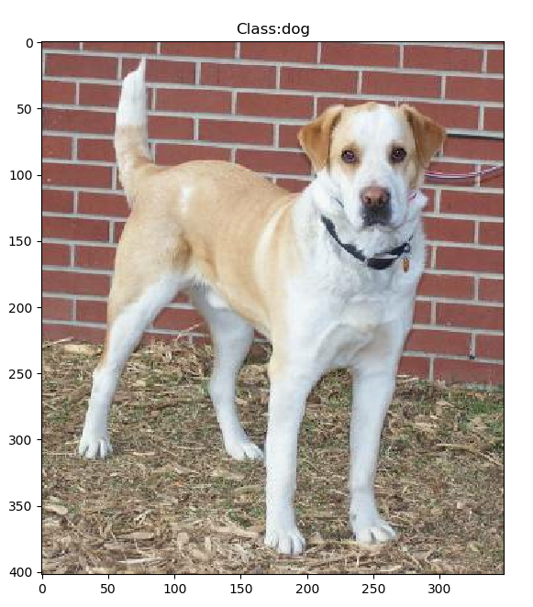
5.1 Training by your computer at least 5 epochs and show(or upload) your source code of ResNet. (5%)
Fig. Accuracy display during training
5.2 Training at home and use TensorBoard to monitor, Save the final screenshot of TensorBoard (5%, Use other tools can get 3%).
Fig. Example of training with TensorBoard
5.3 Randomly select a picture from the test set and mark its category.(5%)
Fig. Classification display example

Slide 20
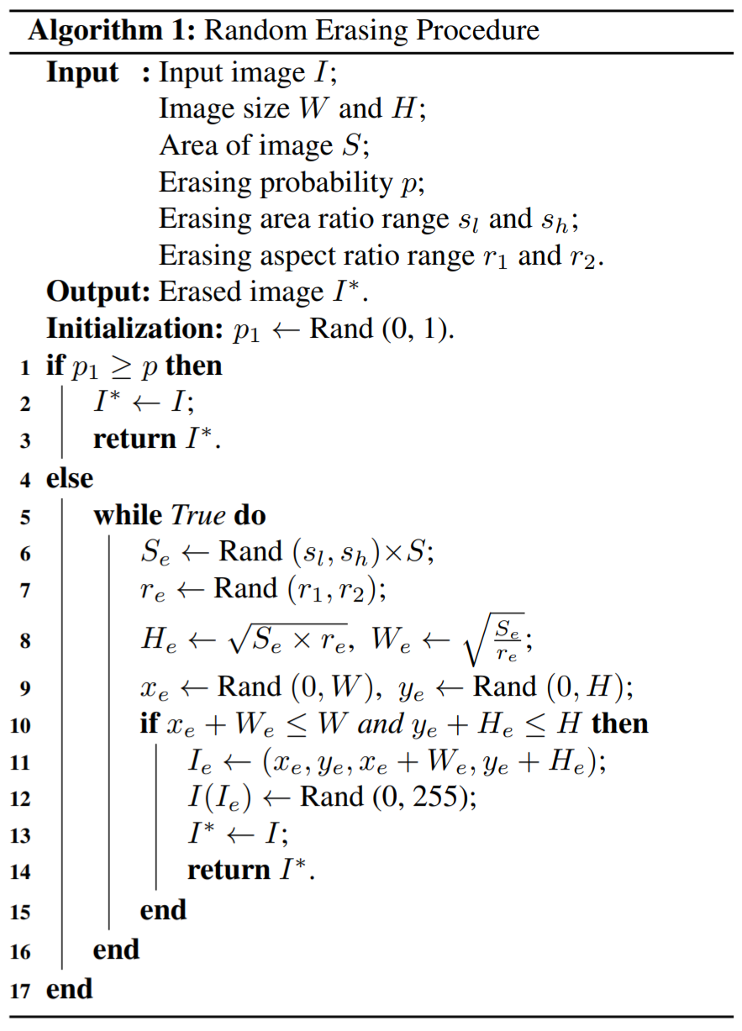
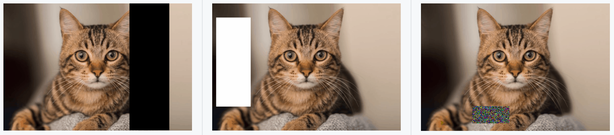
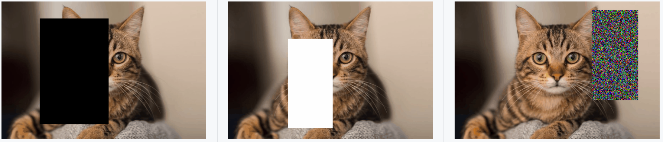
5.4 Improve ResNet50 with the method in yolov4:
Due to the early appearance of ResNet50, many augmentation methods have not implemented. In the latest ResNet50, Random-Erasing have been used to greatly improve the accuracy, so why don‘t we use this method on ResNet50? Write the code of Random-Erasing (3%) and draw the comparison table of accuracy, save it as a picture.(2%)
Fig. Random-Erasing algorithm
Fig. Examples of the use of Random-Erasing
R. Reference
Random Erasing Data Augmentation
Fig. Random-Erasing effect comparison example

